Slide 1
Transformer Networks for Trajectory Forecasting
Presented by
Name: Sazid Hasan Tonmoy
ID: 23241037
Team No: 02
ST: Mehnaz Ara Fazal
RA: Sania Azhmee Bhuiyan

Slide 2


Authors
Francesco Giuliari
Irtiza Hasan
Marco Cristani
Fabio Galasso
University of Verona
Inception Institute of Artificial Intelligence
University of Verona
Sapienza University of Rome
Published In: 2020 25th International Conference on Pattern Recognition (ICPR)

Slide 3
Problem Statement
Research Objective
Challenges the Conventional use of LSTM models in Trajectory forecasting
LSTM Limitations: Sequential processing and difficulty capturing long-range dependencies
Investigate the effectiveness of Transformer networks compared to traditional methods like LSTMs
Develop Simple TF and BERT-based TF models for individual trajectory prediction
Analyze model’s strengths and weaknesses in capturing individual and social dynamics
Propose future research directions

Slide 4
Related Work
Traditional Methods
Recent Advances
Recurrent Neural Networks (RNNs)
Kalman Filters
Social Force Models
Graph Neural Networks (GNNs)
Convolutional Neural Networks (CNNs)
Generative Adversarial Networks (GANs)
Transformer Based Approaches

Slide 5
Implementation Details
TF Parameters: dmodel = 512, 6 layers, 8 attention heads
L2-loss used for predicted vs annotated positions
Optimizer: Adam; linear warm-up (5 epochs), decaying learning rate, and 0.1 dropout
Input Normalization: subtract mean, divide by standard deviation
TFq quantizes motion by clustering speeds into 1000 bins, augmenting data with random scaling (s in [0.5, 2])

Slide 6
Dataset
The TrajNet Dataset
The ETH+UCY Datasets
TrajNet Challenge: Key Trajectory Forecasting Benchmark with diverse datasets
Prediction Task: Forecast 3161 human trajectories, observing 8 and forecasting 12 consecutive values
Metrics: Mean Average Displacement (MAD) & Final Average Displacement (FAD) (Measures Accuracy)
Datasets: 5 videos from 4 scenes: ETH-univ, ETH-hotel, UCY-zara01, UCY-zara02, UCY-univ
Evaluation Protocol: Sampled every 0.4 seconds, observing pedestrians for 3.2 seconds, and predicting the next 4.8 seconds
Metrics: MAD and FAD (Measures Meters)

Slide 7
Evaluation
TRAJNET Challenge
Best-of-20 Protocol
Single Trajectory Deterministic Protocol

Slide 8
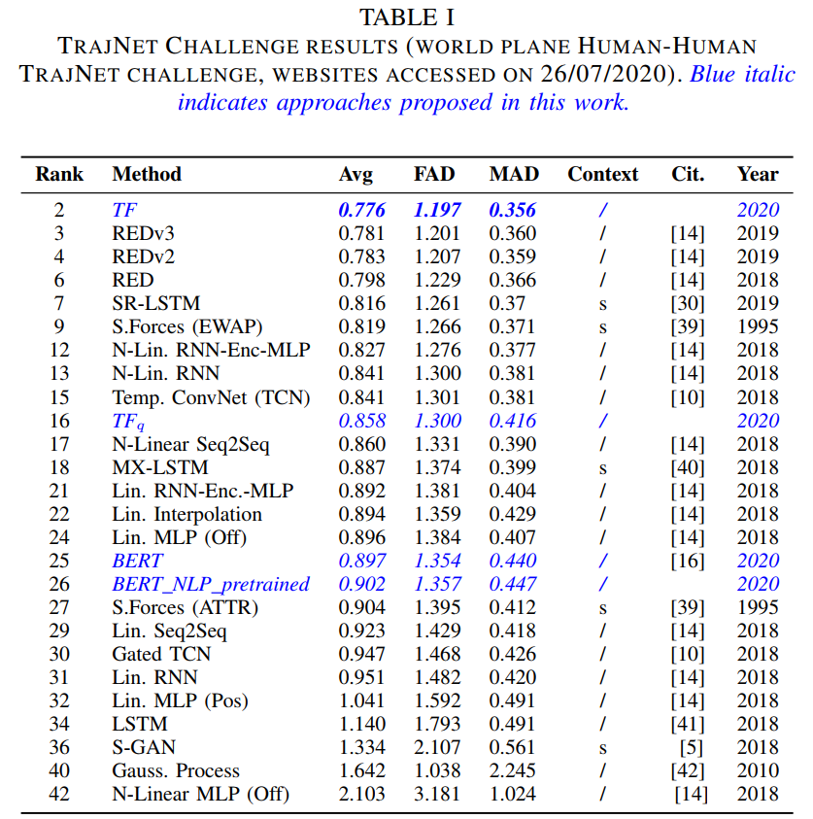
TRAJNET Challenge Results

Slide 9
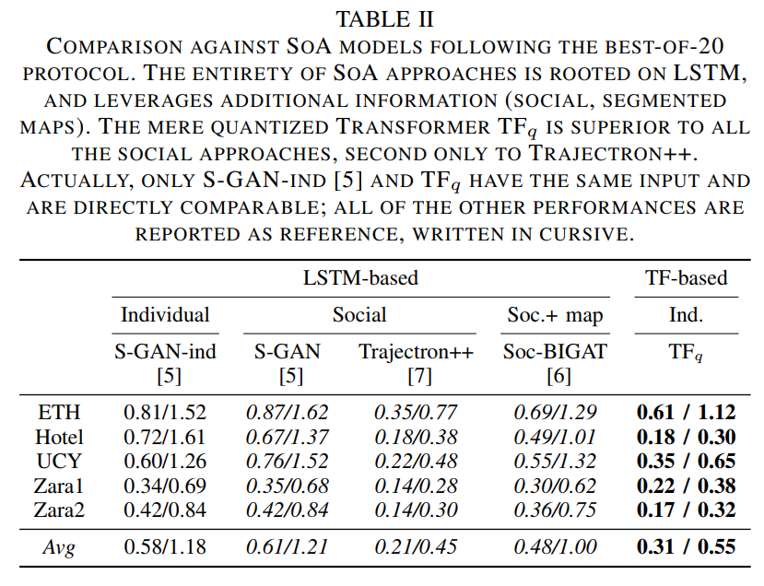
Best-Of-20 Protocol

Slide 10
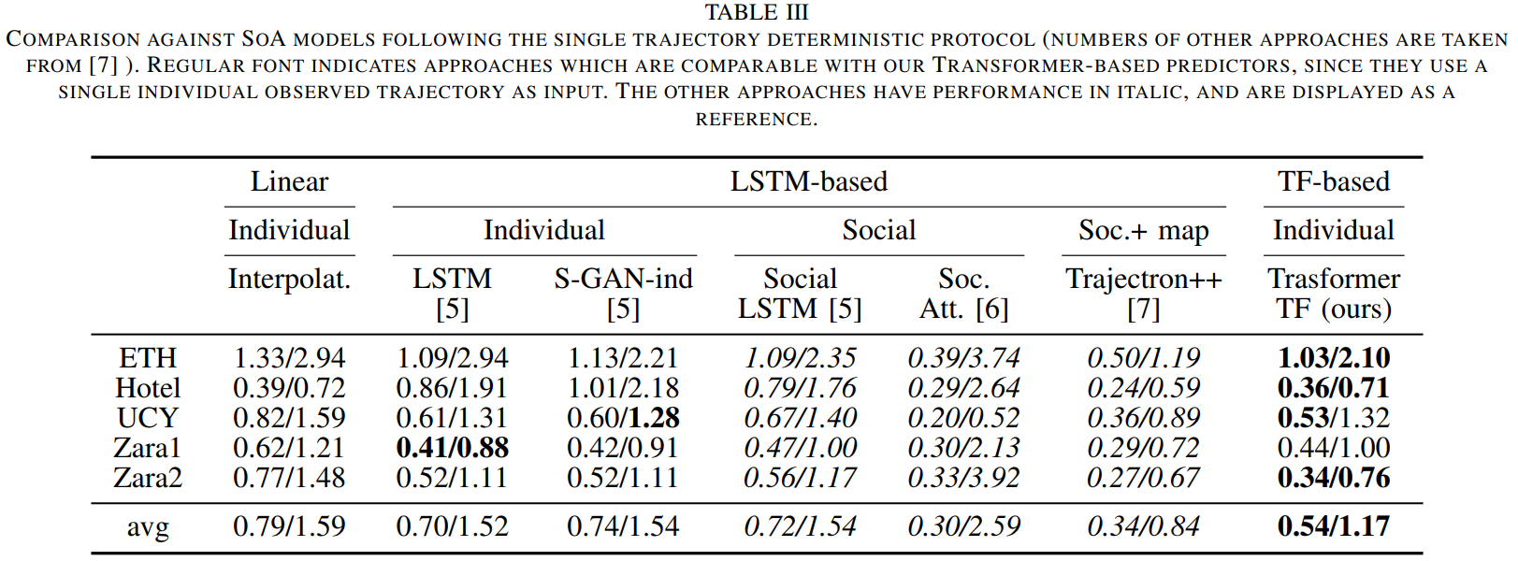
Single Trajectory Deterministic Protocol

Slide 11
Performance
Superior Performance: Outperform LSTM models in trajectory forecasting
TrajNet Success: Achieves top score on TrajNet, even without additional features
Competitive Performance: Transformers perform on par with engineered techniques on ETH+UCY datasets
Handling Missing Data: Transformers demonstrate effective handling of missing observations in real sensor data

Slide 12
Key Contribution
Application of Transformers for individual TF: Previous works focused on multi-agent scenarios
Effectiveness of the Simple TF model: Demonstrating Transformer's potential without explicit interaction modeling
Exploration of BERT for scene context: Highlighting the importance of capturing environment information.
Code Accessibility: Available on GitHub for practical implementation

Slide 13
Practical Implications
Versatile Application: Transformers benefit trajectory forecasting in autonomous driving, pedestrian tracking, and crowd management
Top Performance: Transformers stands out among proposed Transformers in trajectory forecasting benchmarks
Data Robustness: Transformers, especially TF, adeptly handle missing observations, improving applicability in real-world scenarios
Practical Adoption: GitHub code availability streamlines adoption and use of Trajectory Transformers for researchers and practitioners

Slide 14
Weakness and Shortcomings
Future Works
Limited Interaction Modeling
Unaddressed Limitations
Limited Model Comparison
Benchmark Dataset Reliance
Interpretability Gap
Future Model Development
Dataset Generalizability
Scalability and Efficiency Assessment
Integration of Scene and Social Interaction
Robustness Testing
Competitive Comparison

Slide 15
Conclusion
In conclusion, Transformers outshine LSTMs in trajectory forecasting, offering superior performance, long-term prediction, and adaptability to missing data, hinting at broader applications in datasets with extended sequences and social interactions.

Slide 16
Thank You

